Slide 1

Operating system

Slide 2
Content
Process Synchronization
Critical section problem (CSP)
Synchronization constructs

Slide 3
What is Process Synchronization ?
S
When two or more process cooperates with each other, their order of execution must be preserved otherwise there can be conflicts in their execution and inappropriate outputs can be produced.
On the basis of synchronization, processes are categorized as one of the following two types:
Independent Process : Execution of one process does not affects the execution of other processes.
Cooperative Process : Execution of one process affects the execution of other processes.
Note: Process synchronization problem arises in the case of Cooperative process also because resources are shared in Cooperative processes.

Slide 4
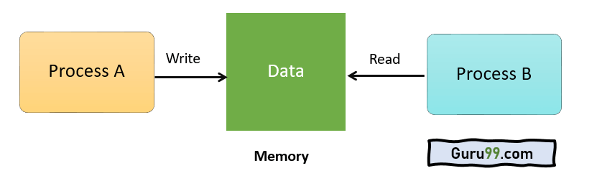
Example:
S
A process A tries changing data in a particular memory location. At the same time another process B tries reading data from the same memory location. Thus, there is a high probability that the data being read by the second process is incorrect.
Need of Synchronization-
When multiple processes execute concurrently sharing some system resources.
To avoid the inconsistent results.

Slide 5

Race Condition
S
A race condition is a condition when there are many processes and every process shares the data with each other and accessing the data concurrently, and the output of execution depends on a particular sequence in which they share the data and access.
A race condition is a situation that may occur inside a critical section.
Race conditions in critical sections can be avoided if the critical section is treated as an atomic instruction.

Slide 6
Sections of a Program in OS
S
1. Entry Section: This decides the entry of any process.
2. Critical Section: This allows a process to enter and modify the shared variable.
3. Exit Section: This allows the process waiting in the Entry Section, to enter into the Critical Sections and makes sure that the process is removed through this section once it’s done executing.
4. Remainder Section: Parts of the Code, not present in the above three sections are collectively called Remainder Section.

Slide 7
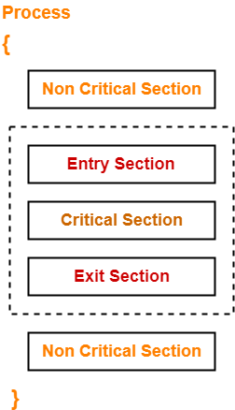
Sections of a Program in OS
S

Slide 8
The Critical Section Problem
S
Critical Section is the part of a program which tries to access shared resources. That resource may be any resource in a computer like a memory location, Data structure, CPU or any IO device.
The critical section cannot be executed by more than one process at the same time; operating system faces the difficulties in allowing and disallowing the processes from entering the critical section.
The critical section problem is used to design a set of protocols which can ensure that the Race condition among the processes will never arise.
In order to synchronize the cooperative processes, our main task is to solve the critical section problem. We need to provide a solution in such a way that the following conditions can be satisfied.

Slide 9
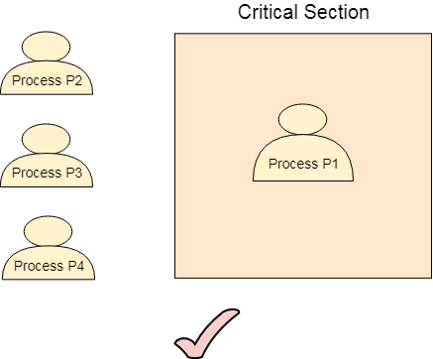
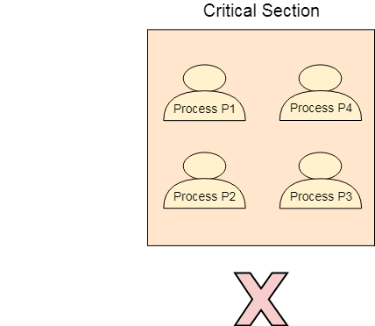
Requirements of Synchronization mechanisms (Criterion to solve CS Problem)
S
Mutual Exclusion: If a process is executing in its critical section, then no other process is allowed to execute in the critical section.

Slide 10
Requirements of Synchronization mechanisms
S
Progress:
Progress means that if one process doesn't need to execute into a critical section then it should not stop other processes to get into the critical section
We use it when the critical section is empty, and a process wants to enter it. The processes that are not present in their reminder section decide who should go in, within a finite time.
Note: Should not lead to the deadlock

Slide 11
Requirements of Synchronization mechanisms
S
Bounded Waiting:
We should be able to predict the waiting time for every process to get into the critical section. The process must not be endlessly waiting for getting into the critical section.
Only a specific number of processes are allowed into their critical section. Thus, a process needs to make a request when it wants to enter the critical section and when the critical section reaches its limit, the system allows the process’ request and allows it into its critical section..
Architectural Neutral:
It can run on any architecture without any problem.
There is no dependency on the architecture.

Slide 12
Solution to Critical Section Problem
S
Software based solution
Peterson’s solution
Hardware based solutions
Disable interrupts
Atomic instructions: TestAndSet and Swap
OS solutions:
Semaphore

Slide 13
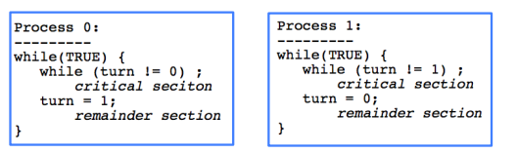
A Simple Solution
S
Bool turn;->indicate whose turn to enter CS
T0 and T1: alternate between CS and remainder
Pros:
1. Pi’s critical section is executed
iff turn = i
2. Pi is busy waiting if Pj is in CS
(mutual exclusion)
Cons:
Progress is not satisfied since it requires strict alternation
A process cannot enter the CS more often than the other.

Slide 14
Semaphore:

Slide 15
Thank You

